Slide 1
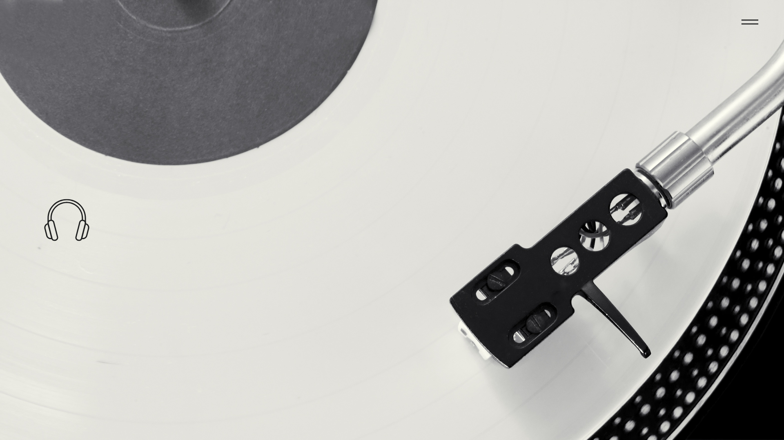
Chinook Music Store Analysis
Presented by Tuhina Ghosh
14/09/2025

Slide 2
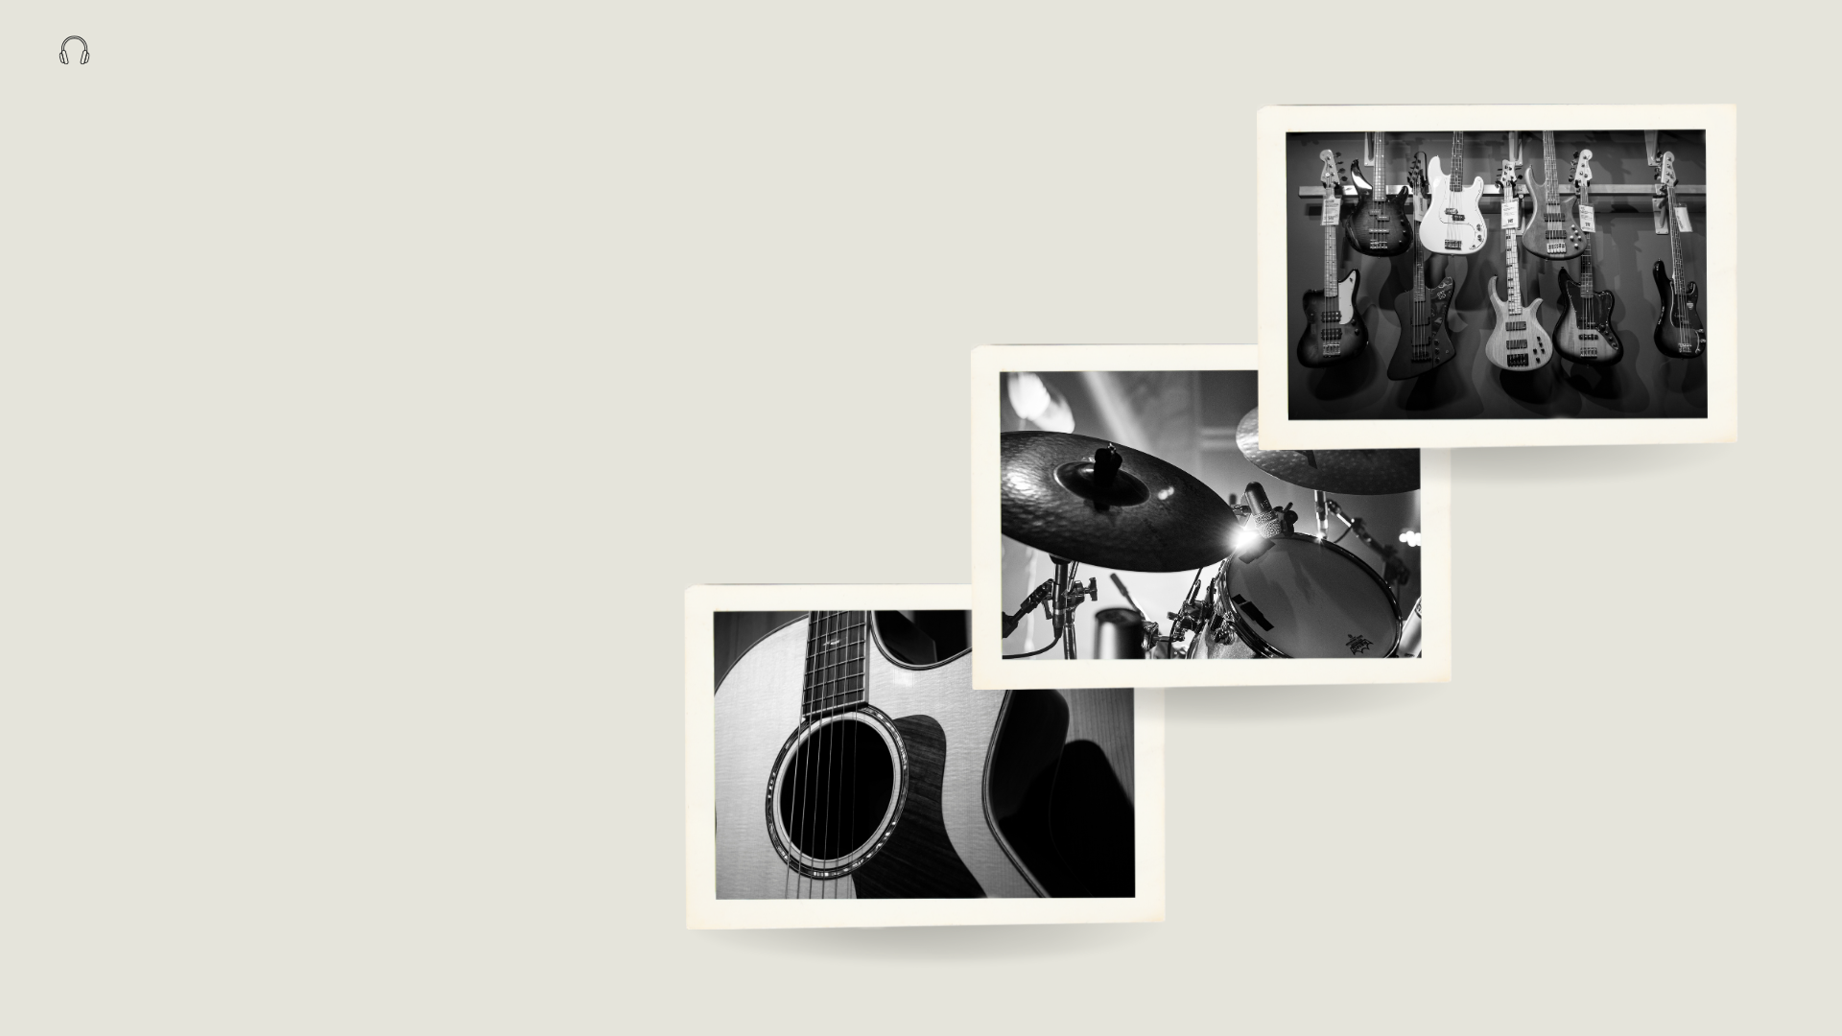
Agenda
About Chinook
Problem Statement
Data Description
Objective Key Metrics and Visualizations
Subjective Question for Insights

Slide 3
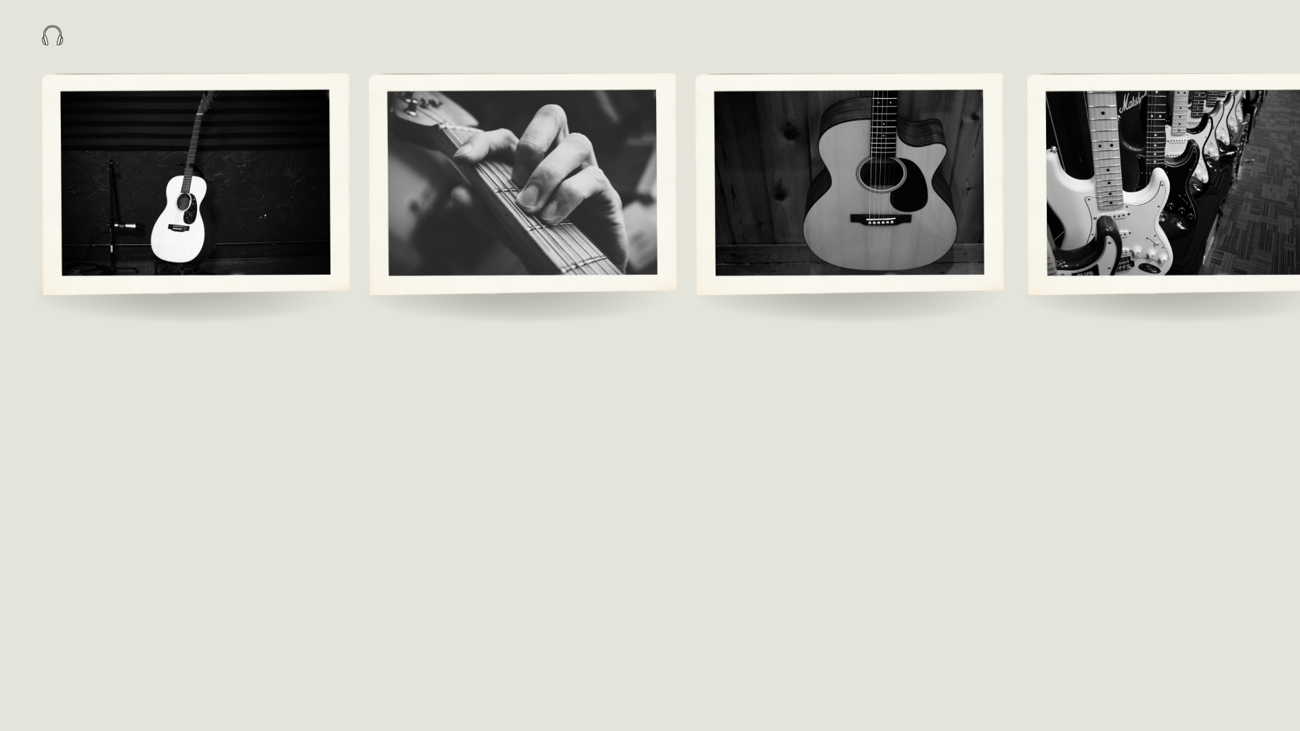
About Chinook Store
Established in 1995, Chinook Music Service has been North Central Washington’s number one source for music instruments, accessories, band and orchestra rentals and repairs.
Chinook Music is a company that operates both a digital music store and a music school with physical location.
The digital store is represented by the Chinook Music Store Database, often used for data analysis and learning SQL.

Slide 4
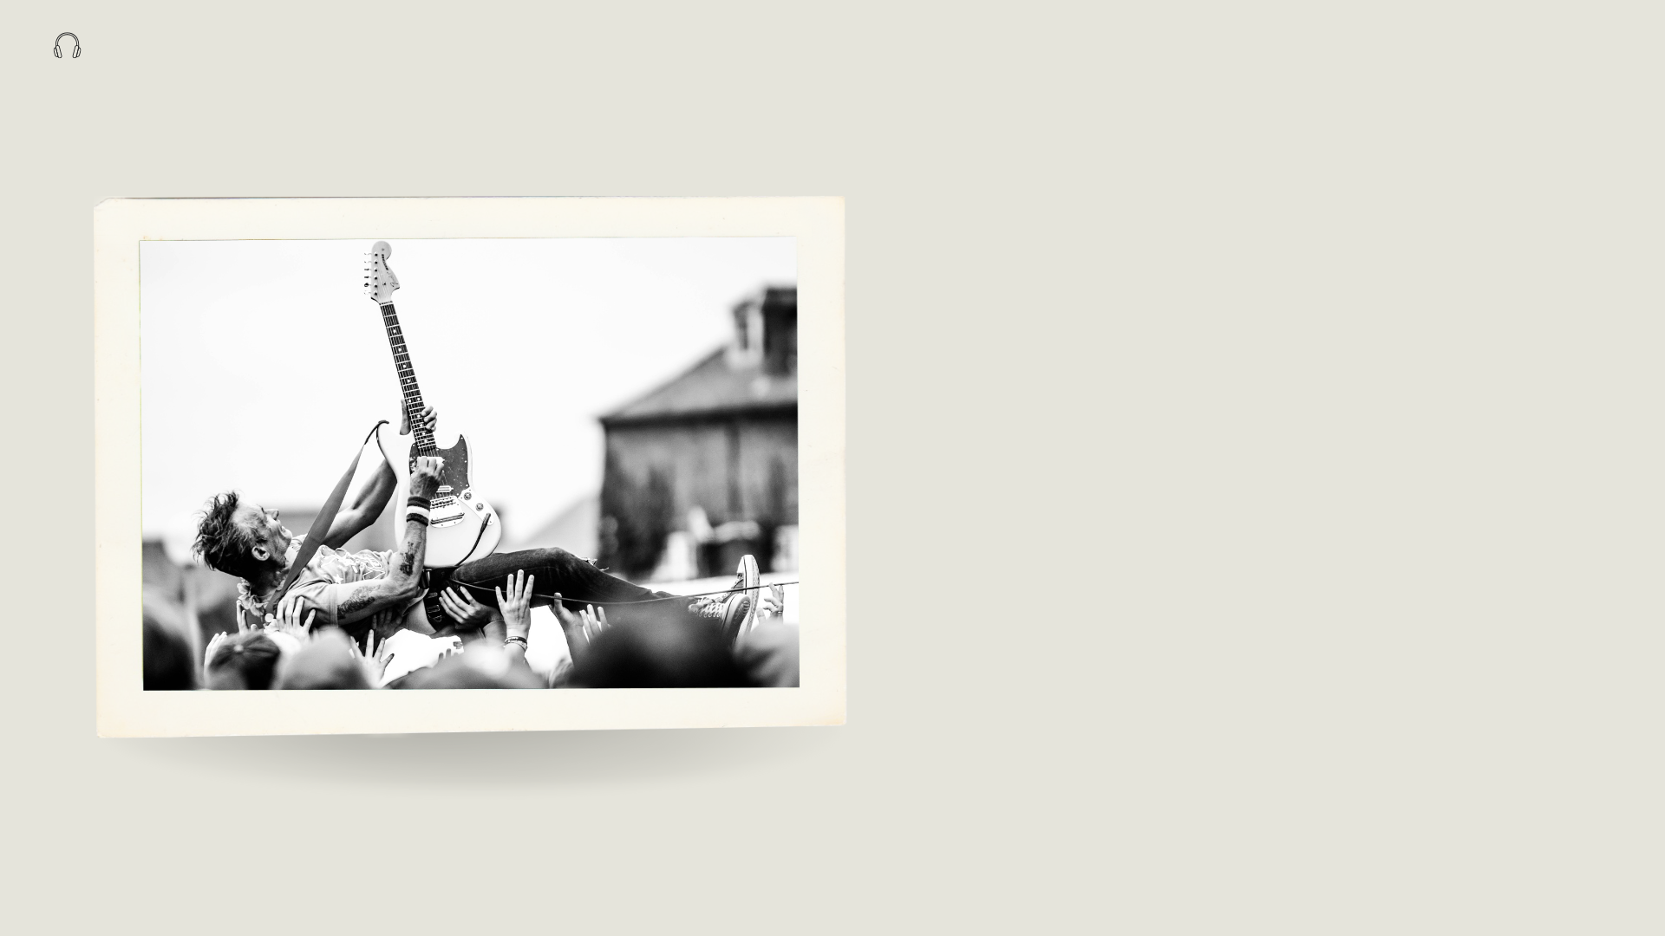
Business Goal
Since the music store holds large amounts of sales and customer data, so the main objective is to analyze music record sales data by
Identifying which genres, artists and album drive the most sales
Understanding the customer preferences and their purchasing behavior
Recognizing trends and underperforming areas
to gain insights and make informed strategic decisions / recommendations for growth in the physical music market.

Slide 5

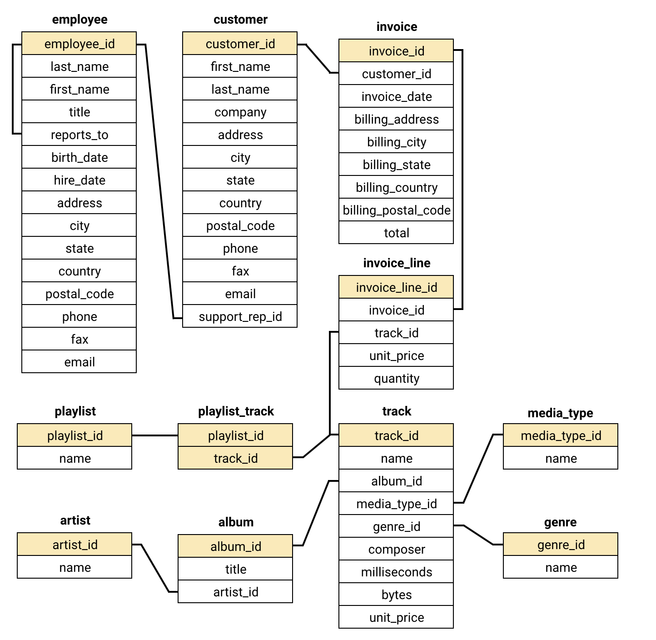
Database schema

Slide 6
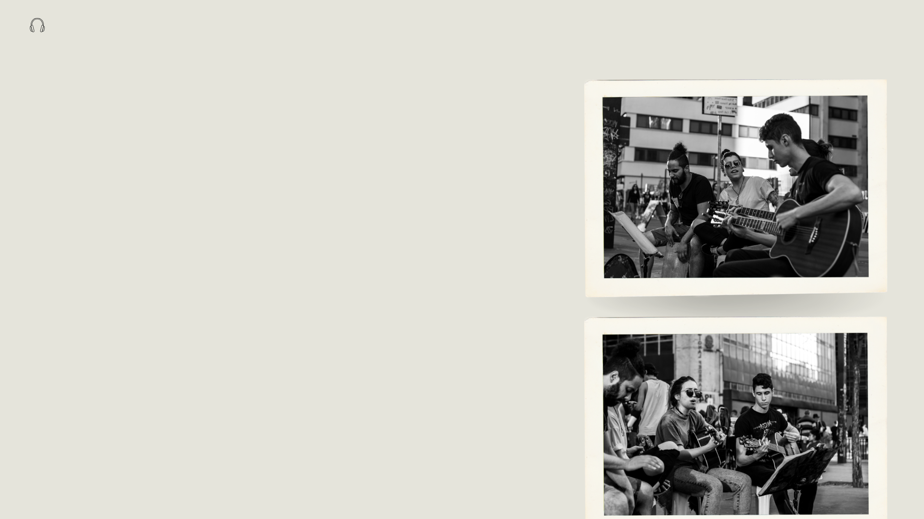
Data Understanding
This dataset provides a comprehensive view of Chinook’s market presence and operations.
The dataset consists of 11 relational tables containing information about the company’s operations.
Chinook has a global customer base across 24 countries.
The music catalog covers 25 genres such as Rock, Metal, Jazz, Classical, and more.
Each track is linked to its album and artist information, allowing deeper analysis of music trends.
The invoice table records all transactions, enabling sales and revenue analysis.

Slide 7

Methodology
Understanding The Data
Cleaning The Data
Exploring The Data
Deriving Key Insights

Slide 8
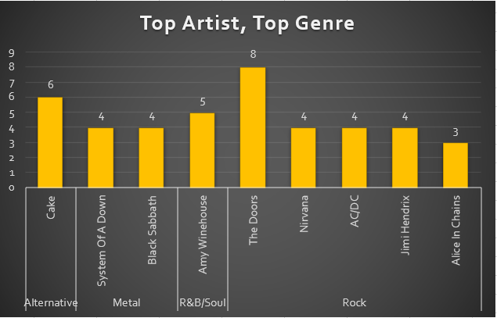
Analysis Of Data
Key Takeaways :
Top Genre by Revenue
Rock is the leading genre, contributing the largest share of revenue → shows customer preference is highly skewed.
Other genres like Alternative, Metal, R&B/Soul contribute moderately, while many genres add only a small share.
The company is heavily dependent on one genre, which could be both a strength (clear demand) and a risk (lack of diversification).

Slide 9
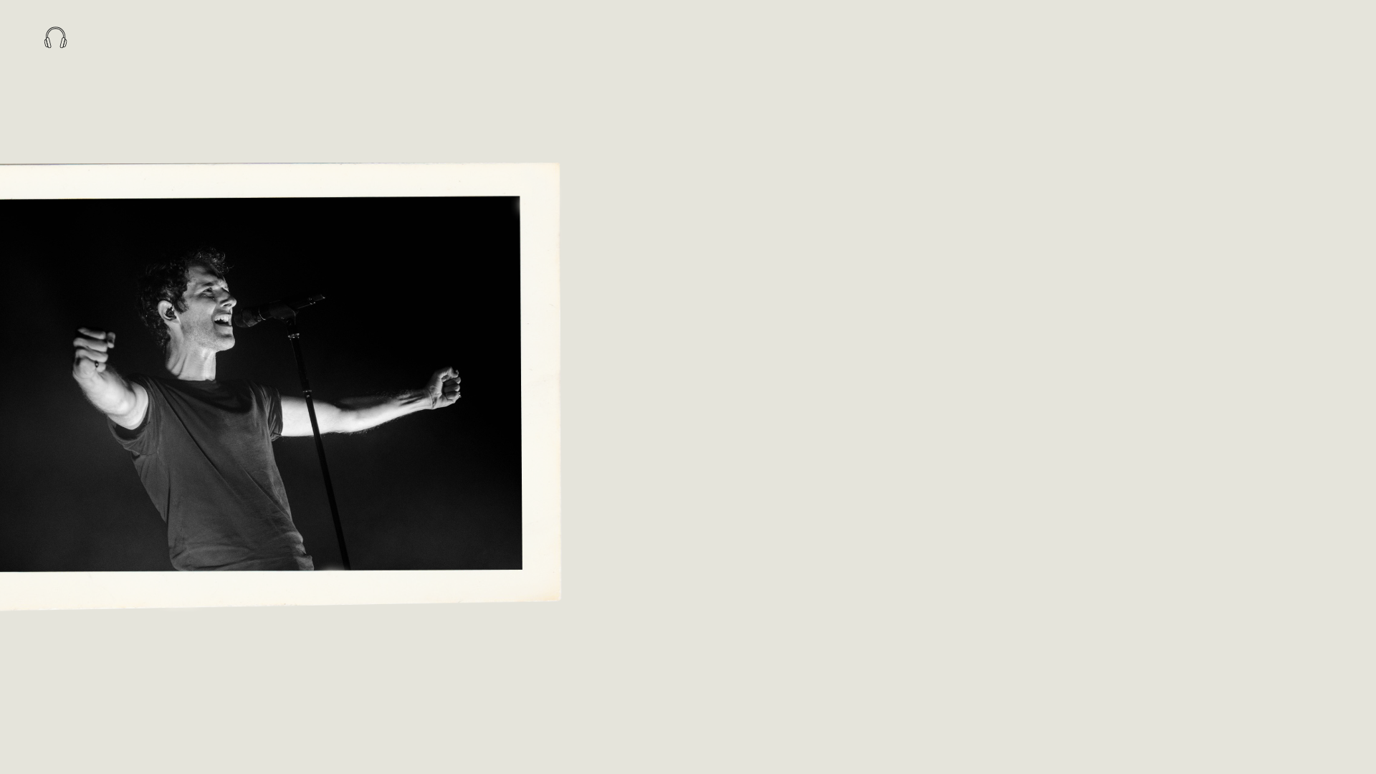
Key Takeaways :
Top Artist by Revenue
A few artists such as The Doors, Nirvana, AC/DC, Amy Winehouse generate a large portion of overall sales.
Sales are concentrated among superstar artists, while the majority of artists contribute minimally.
Indicates opportunities for artist-focused promotions, exclusive releases, or partnerships with these high-selling artists.

Slide 10
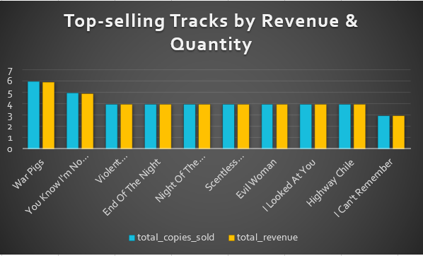
Key Takeaways :
Few tracks dominate sales → A small set of popular songs drive the majority of revenue & copies sold.
Revenue vs. Quantity difference → Some tracks sell fewer copies at higher prices, while others sell more copies but generate less revenue.
Opportunity → Focus marketing on high-selling tracks while also bundling or promoting mid-performing tracks to boost overall sales.

Slide 11
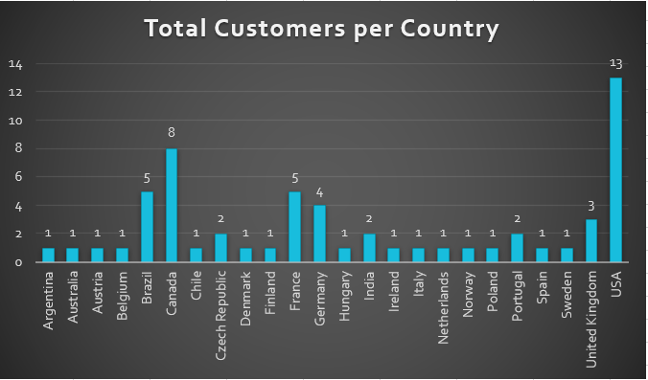
Key Takeaways :
Customer Demographic Breakdown Based on Location
It shows that the customers are from 24 different countries.
The customer demographic breakdown is very diversified.
Maximum number of customers are from USA.

Slide 12
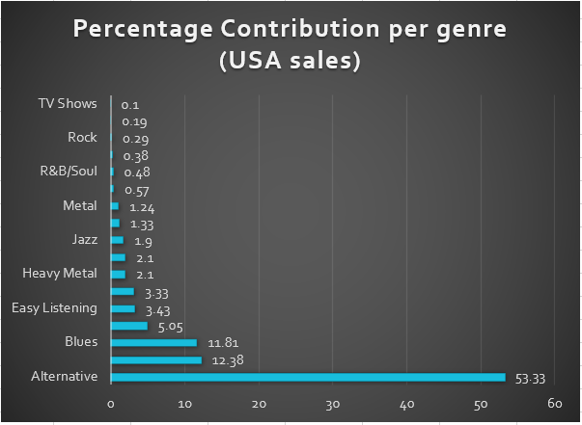
Key Takeaways :
Calculate The Percentage Of Total Sales Contributed By each Genre In The USA
It shows that Alternative genre is contributing most to the Sales generated in the USA.
The 2nd and 3rd most selling genres are Rock, Punk and Blues.

Slide 13
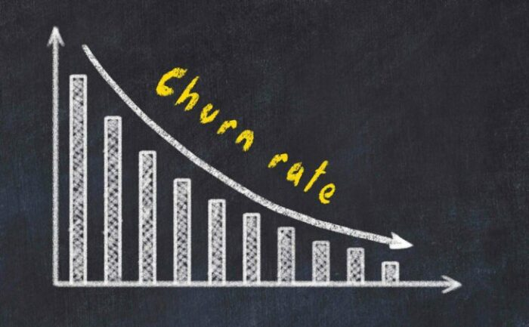
Key Takeaways :
On Customer Churn Rate
Many customers buy only once and don’t return. High churn indicates low customer retention and a need for stronger engagement strategies.
This means the company is losing customers quickly. This is showing a risk of losing long-term revenue.
New offers, Promotional campaigns, music festivals, and seasonal discounts can encourage repeat purchases and bring customers back.
Good customer service can also help keep customers for longer.
27.1168

Slide 14
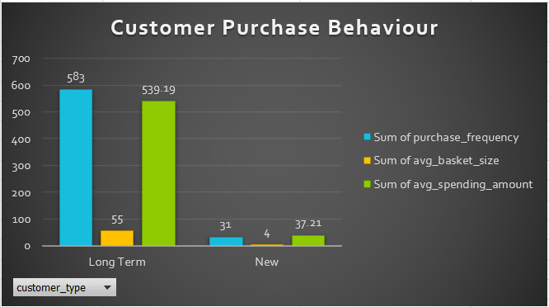
Key Takeaways :
Customer Purchasing Behavior Analysis
Long-term customers make far more purchases (583) and contribute the majority of total spending. Their average spending amount (539) is much higher compared to new customers.
New customers show very low purchase frequency and basket size, meaning most of them churn quickly.
The company’s growth depends on retaining long-term customers and converting new buyers into repeat customers.
Most revenue comes from long-term customers. New customers drop off fast, which increases churn. If we improve engagement and offer better deals for new buyers, we can convert them into loyal customers.

Slide 15
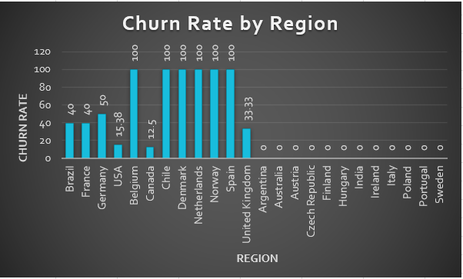
Key Takeaways :
Regional Market Analysis
USA has the highest number of customers, orders, and revenue. Rock music’s popularity could be a big reason.
Canada comes second in customers, orders, and revenue. English language and developed economy may explain this.
Czech Republic has the highest average order value (9.11) and purchase frequency (15 orders per customer). This suggests people there spend more on music.
Countries like Spain, Norway, and Netherlands show a 100% churn rate, but each has only 1 customer, so this isn’t meaningful.
Among big markets:
USA churn rate = 15.38%
Canada churn rate = 12.50%
Germany shows a churn rate of 50% (2 of 4 customers stopped buying).
France and Brazil each have a churn rate of 40% (2 of 5 customers churned). This may be due to less interest in English-language music.

Slide 16
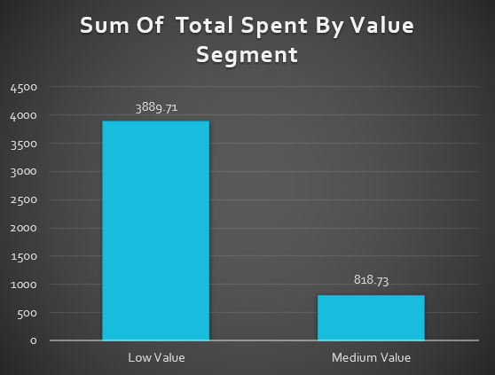
Key Takeaways :
Customer Risk Profiling
Majority of customers are classified as High Risk due to long inactivity periods (most last purchases over 1700 days ago).
Even customers with frequent orders have Low Value, indicating low spending per order.
Countries like Canada, Denmark, Argentina, Italy, USA, and Belgium have several high-risk, low-value customers.

Slide 17

Recommendations
The company should prioritize the USA market and launch additional promotional campaigns.
The company should focus on expanding its services to additional countries in order to grow its customer base.
Customer retention should be the top priority to help increase revenue.
The company should take steps to lower customer churn in the recommended countries by implementing strategies such as loyalty programs, targeted promotions, and improved customer support.
The company should focus on maintaining steady sales and driving month-over-month growth.
The company should offer personalized recommendations to every customer to boost engagement and sales.
Use email marketing to notify customers about the latest discounts and special offers.

Slide 18
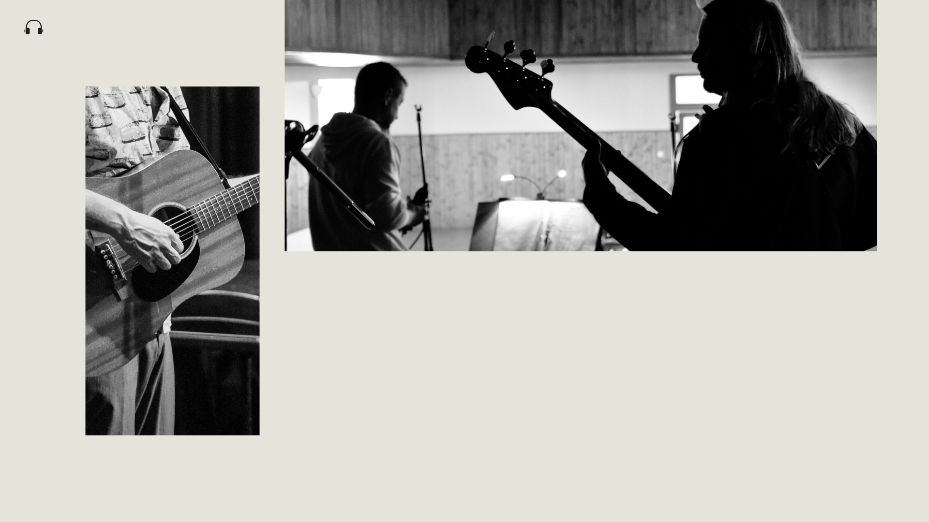
Thank You !

